Slide 1
Right Physical Home Search Committee
Family Meeting Update
Unity Center of Light
Bowie, Maryland
November 22, 2015

Slide 2

GOAL
To assist the Unity Center of Light Board of Trustees (BOT), Finance Committee and church membership in the selection of a new physical home.

Slide 3
Committee Members
Chairperson:
Co-Chair:
Co-Chair:
Real Estate Liaison
Webmaster
Willie Sutton
Maurice Jackson
Jacquie Jackson
Linda Jackson Smith
Phyllis Chesley
Carolyn Dickerson
Sharon Duncan
Colette DeChalus Lee

Slide 4
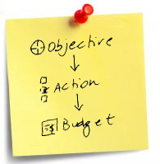
OBJECTIVES
Define the key characteristics of our desired new physical home.
Identify and address the key steps, deliverables, and concerns for our search effort regarding items such as communications, research, financing, approvals, etc.
Research and recommend a financing solution (e.g. financial institution, loan terms, etc.).
Research available properties and present an initial recommendation for a new physical home by the February 2015 family meeting.

Slide 5

Objective 1:
Define Key characteristics of our Right Physical Home (RPH)
Accomplishments:
Conducted extensive survey of the congregation via Survey Monkey in Dec. 2014; obtained 101 respondents.
Survey results and BOT input used to formulate a detailed list of RPH key characteristics.
Survey results also highlighted a strong desire for an interim physical home that unifies the sanctuary, offices, classrooms and bookstore under one roof.
Committee strategy modified to simultaneously look for:
  new physical home for purchase, and
  improved interim solution.
Cont’d
Notes:
Survey results and BOT input used to formulate a detailed list of RPH key characteristics(i.e., physical qualities, geographic preferences, etc. /all shared in previous Family Meeting)

Slide 6
Objective 2:
Identify and address key steps, deliverables and concerns.
Accomplishments:
Created a RPH website\blog to facilitate communication with the church membership.
Bi-weekly Search Committee meetings/phone conferences, meeting minutes. Periodic meetings with the Board of Trustees.
Gathered lessons learned from other UCL churches.
Researched the option of a Capital Campaign.
Researched the pre-engineered steel building option.
  Visited MACC Church in Gambrills with SBS.
Notes:
Bi-weekly meetings/phone conferences confirmed by minutes, most not published to the website to maintain negotiation privacy

Slide 7
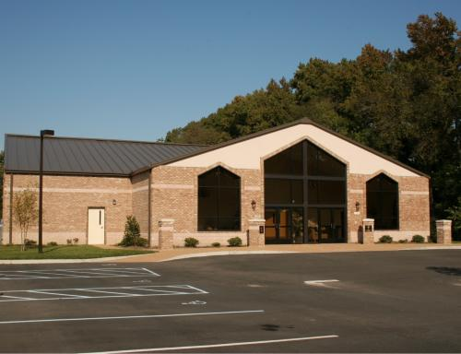
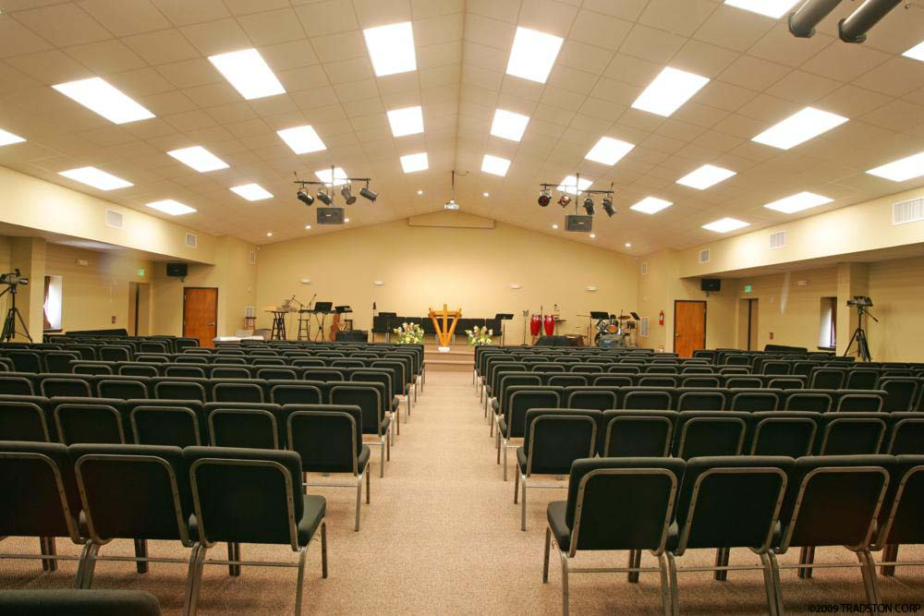
Pre-engineered Steel
Building Example

Slide 8
Objective 3:
Research and recommend a financing solution
Accomplishments:
Interviewed bank officers to assess the resources UCL Board of Trustees need to provide before any transaction takes place.
Recommended 2 banks for possible loan acquisition.
Researched and began development of bank applications for a loan pre-approval.

Slide 9
Objective 4:
Research available properties and present recommendations
Accomplishments:
Interviewed real estate agents, selecting NAI Michael because they excel in commercial real estate and have strong ties to/influence in PG County.
                Established Real Estate Guidelines for desired location.
Researched interim and permanent property solutions.
Developed Lessons Learned:
  Properties matching our needs are very scarce in Bowie area.
  An interim solution needs to be “move in ready”.

Slide 10

Update from Rev. Mosby

Slide 11
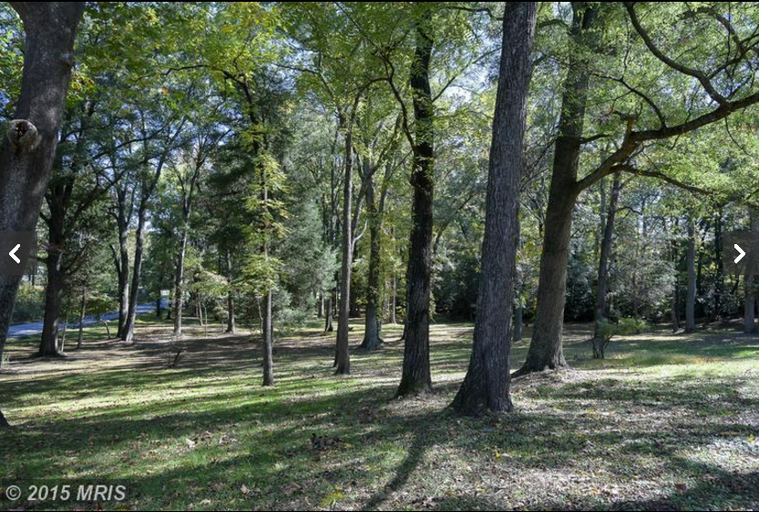
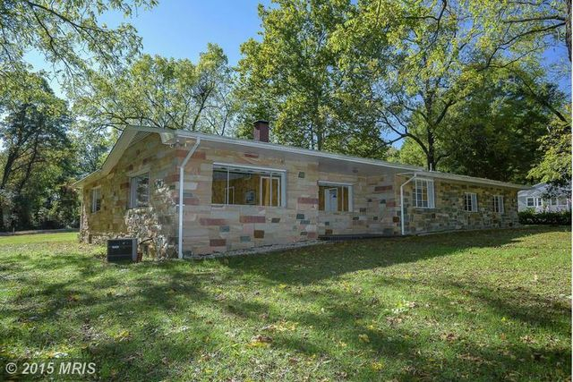
In Negotiation…5 acres
14201 Lancaster Lane, Bowie

Slide 12
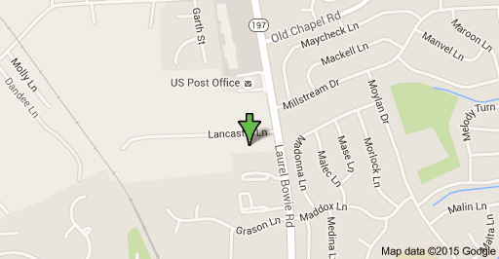
14201 Lancaster Lane, Bowie

Slide 13
Conclusions:
Right Physical Home Search Committee has completed its goal and objectives.
Board of Trustees will move forward with next steps and ongoing activities.
The Board may solicit assistance from new working groups, volunteers, and/or former Search Committee members.
“We are thankful for the guidance of Spirit that has led us to our right spiritual home.”

Slide 14
In Closing
The Search Committee thanks you for your participation as we all worked together to achieve our goals and objectives during these last 14 months.
We encourage you to continue to utilize our blog and social media accounts to provide continued feedback:
http://rightphysicalhome.weebly.com/
https://www.facebook.com/groups/UnityCenterofLight/
https://twitter.com/UCLBowie
Portions of this committee report will be made available on the Right Physical Home website after the Thanksgiving holiday.

